Slide 1
Matrix Chain Multiplication using Dynamic Programming

Slide 2

Matrix-chain Multiplication
Suppose we have a sequence or chain A₁, A₂, …, A_{n} of n matrices to be multiplied
That is, we want to compute the product A₁A₂…A_{n}
There are many possible ways (parenthesizations) to compute the product

Slide 3
Matrix-chain Multiplication …contd
Example: consider the chain A₁, A₂, A₃, A₄ of 4 matrices
Let us compute the product A₁A₂A₃A₄
There are 5 possible ways:
(A₁(A₂(A₃A₄)))
(A₁((A₂A₃)A₄))
((A₁A₂)(A₃A₄))
((A₁(A₂A₃))A₄)
(((A₁A₂)A₃)A₄)

Slide 4
Matrix-chain Multiplication …contd
To compute the number of scalar multiplications necessary, we must know:
Algorithm to multiply two matrices
Matrix dimensions
Can you write the algorithm to multiply two matrices?

Slide 5
Algorithm to Multiply 2 Matrices
Input: Matrices A_{p×q} and B_{q×r} (with dimensions p×q and q×r)
Result: Matrix C_{p×r} resulting from the product A·B
MATRIX-MULTIPLY(A_{p×q} , B_{q×r})
1. for i ← 1 to p
2. for j ← 1 to r
3. C[i, j] ← 0
4. for k ← 1 to q
5. C[i, j] ← C[i, j] + A[i, k] · B[k, j]
6. return C
Scalar multiplication in line 5 dominates time to compute CNumber of scalar multiplications = pqr

Slide 6
Matrix-chain Multiplication …contd
Example: Consider three matrices A_{10×100}, B_{100×5}, and C_{5×50}
There are 2 ways to parenthesize
((AB)C) = D_{10×5} · C_{5×50}
AB ⇒ 10·100·5=5,000 scalar multiplications
DC ⇒ 10·5·50 =2,500 scalar multiplications
(A(BC)) = A_{10×100} · E_{100×50}
BC ⇒ 100·5·50=25,000 scalar multiplications
AE ⇒ 10·100·50 =50,000 scalar multiplications
Total: 7,500
Total: 75,000

Slide 7
Matrix-chain Multiplication …contd
Matrix-chain multiplication problem
Given a chain A₁, A₂, …, A_{n} of n matrices, where for i=1, 2, …, n, matrix A_{i} has dimension p_{i-1}×p_{i}
Parenthesize the product A₁A₂…A_{n} such that the total number of scalar multiplications is minimized

Slide 8
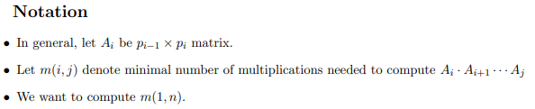


Recursive Algorithm
We need to identify at which matrix the split has to be done. Let us assume that at matrix k we can split. Ie (A_{i}…A_{k})(A_{k+1}…A_{j})
But we need to compute recursively the best way to multiply the chain from i to k, and from k + 1 to j, and add the cost of the final product. This means that
we have to try all possible values of k and pick the best solution

Slide 9
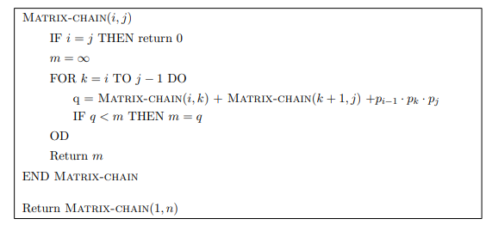
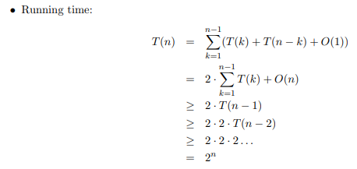
Recursive Algorithm
Exponential is ... SLOW!

Slide 10
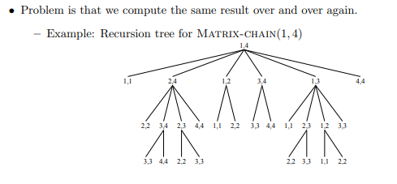
Can we apply dynamic programming
Are we looking for optimal substructure

Slide 11
Can we apply dynamic programming
Are we looking for optimal substructure

Slide 12
Can we apply dynamic programming
Do we have overlapping subproblems

Slide 13
Can we apply dynamic programming
Do we have overlapping subproblems

Slide 14
Dynamic Programming Approach
The structure of an optimal solution
Let us use the notation A_{i..j} for the matrix that results from the product A_{i} A_{i+1} … A_{j}
An optimal parenthesization of the product A₁A₂…A_{n} splits the product between A_{k} and A_{k+1} for some integer k where1 ≤ k < n
First compute matrices A_{1..k} and A_{k+1..n} ; then multiply them to get the final matrix A_{1..n}

Slide 15
Dynamic Programming Approach …contd
Key observation: parenthesizations of the subchains A₁A₂…A_{k} and A_{k+1}A_{k+2}…A_{n} must also be optimal if the parenthesization of the chain A₁A₂…A_{n} is optimal
That is, the optimal solution to the problem contains within it the optimal solution to subproblems

Slide 16
Dynamic Programming Approach …contd
Recursive definition of the value of an optimal solution
Let m[i, j] be the minimum number of scalar multiplications necessary to compute A_{i..j}
Minimum cost to compute A_{1..n} is m[1, n]
Suppose the optimal parenthesization of A_{i..j} splits the product between A_{k} and A_{k+1} for some integer k where i ≤ k < j

Slide 17
Dynamic Programming Approach …contd
A_{i..j} = (A_{i} A_{i+1}…A_{k})·(A_{k+1}A_{k+2}…A_{j})= A_{i..k} · A_{k+1..j}
Cost of computing A_{i..j} = cost of computing A_{i..k} + cost of computing A_{k+1..j} + cost of multiplying A_{i..k} and A_{k+1..j}
Cost of multiplying A_{i..k} and A_{k+1..j} is p_{i-1}p_{k} p_{j}
m[i, j ] = m[i, k] + m[k+1, j ] + p_{i-1}p_{k} p_{j} for i ≤ k < j
m[i, i ] = 0 for i=1,2,…,n

Slide 18
Dynamic Programming Approach …contd
But… optimal parenthesization occurs at one value of k among all possible i ≤ k < j
Check all these and select the best one
0 if i=j
m[i, j ] =
min {m[i, k] + m[k+1, j ] + p_{i-1}p_{k} p_{j} } if i<j
i ≤ k< j

Slide 19
Dynamic Programming Approach …contd
To keep track of how to construct an optimal solution, we use a table s
s[i, j ] = value of k at which A_{i} A_{i+1} … A_{j} is split for optimal parenthesization
Algorithm:
First computes costs for chains of length l=1
Then for chains of length l=2,3, … and so on
Computes the optimal cost bottom-up

Slide 20
Algorithm to Compute Optimal Cost
Input: Array p[0…n] containing matrix dimensions and n
Result: Minimum-cost table m and split table s
MATRIX-CHAIN-ORDER(p[ ], n)
for i ← 1 to n
m[i, i] ← 0
for l ← 2 to n
for i ← 1 to n-l+1
j ← i+l-1
m[i, j] ← ∞
for k ← i to j-1
q ← m[i, k] + m[k+1, j] + p[i-1] p[k] p[j]
if q < m[i, j]
m[i, j] ← q
s[i, j] ← k
return m and s
Takes O(n³) time
Requires O(n²) space

Slide 21
Constructing Optimal Solution
Our algorithm computes the minimum-cost table m and the split table s
The optimal solution can be constructed from the split table s
Each entry s[i, j ]=k shows where to split the product A_{i} A_{i+1} … A_{j} for the minimum cost

Slide 22
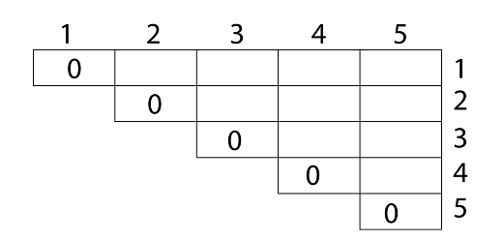
Example
We are given the sequence A₁, A₂ , A₃, A_{4,} A₅ The matrices have size 4 x 10, 10 x 3, 3 x 12, 12 x 20, 20 x 7
We need to compute M [i,j], 0 ≤ i, j≤ 5. We know M [i, i] = 0 for all i.

Slide 23
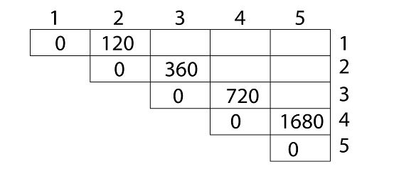
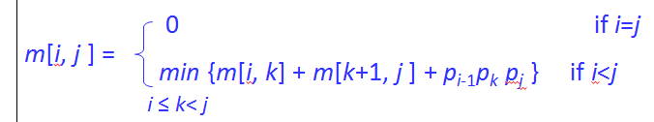
Calculation of Product of 2 matrices: 1. m (1,2) = m1 x m2 = 4 x 10 x 10 x 3 = 4 x 10 x 3 = 120 2. m (2, 3) = m2 x m3 = 10 x 3 x 3 x 12 = 10 x 3 x 12 = 360 3. m (3, 4) = m3 x m4 = 3 x 12 x 12 x 20 = 3 x 12 x 20 = 720 4. m (4,5) = m4 x m5 = 12 x 20 x 20 x 7 = 12 x 20 x 7 = 1680
1 | 2 | 3 | 4 | 5
s
0 | 1
1
2
3
4
5
0 | 2
0 | 3
0 | 4
0

Slide 24
Now product of 3 matrices:
M [1, 3] = M1 M2 M3
There are two cases by which we can solve this multiplication:
( M1 x M2) x M3,
M1x (M2x M3)
After solving both cases we choose the case in which minimum output is there.
M [1, 3] =264
M [2, 4] = M2 M3 M4
There are two cases by which we can solve this multiplication:
(M2x M3)xM4, M2x (M3 x M4)
After solving both cases we choose the case in which minimum output is there.
M [2, 4] = 1320

Slide 25



Slide 26

M [3, 5] = M3 M4 M5There are two cases by which we can solve this multiplication: ( M3 x M4) x M5, M3x ( M4xM5)
After solving both cases we choose the case in which minimum output is there.
M [3, 5] = 1140

Slide 27
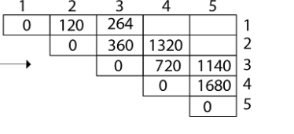
1 | 2 | 3 | 4 | 5
s
0 | 1 | 2
1
2
3
4
5
0 | 2 | 2
0 | 3 | 4
0 | 4
0

Slide 28

Now Product of 4 matrices:
M [1, 4] = M1 M2 M3 M4
There are three cases by which we can solve this multiplication:
( M1 x M2 x M3) M4
M1 x(M2 x M3 x M4)
(M1 xM2) x ( M3 x M4)
After solving these cases we choose the case in which minimum output is there
M [1, 4] =1080

Slide 29
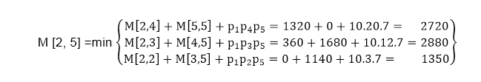
M [2, 5] = M2 M3 M4 M5
There are three cases by which we can solve this multiplication:
(M2 x M3 x M4)x M5
M2 x( M3 x M4 x M5)
(M2 x M3)x ( M4 x M5)
After solving these cases we choose the case in which minimum output is there
M [2, 5] = 1350

Slide 30
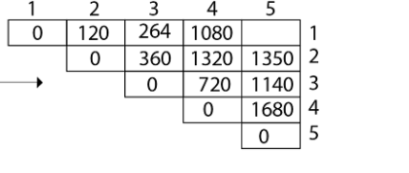
1 | 2 | 3 | 4 | 5
s
0 | 1 | 2 | 2
1
2
3
4
5
0 | 2 | 2 | 2
0 | 3 | 4
0 | 4
0

Slide 31
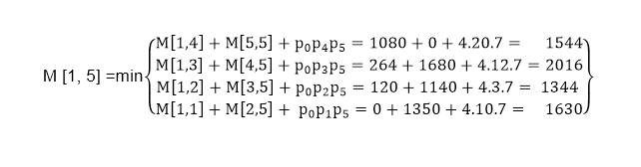
Now Product of 5 matrices:
M [1, 5] = M1 M2 M3 M4 M5
There are five cases by which we can solve this multiplication:
(M1 x M2 xM3 x M4 )x M5
M1 x( M2 xM3 x M4 xM5)
(M1 x M2 xM3)x M4 xM5
M1 x M2x(M3 x M4 xM5)
After solving these cases we choose the case in which minimum output is there
M [1, 5] = 1344

Slide 32
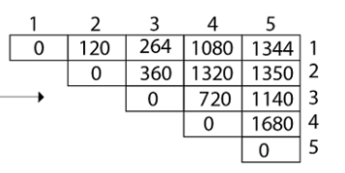
1 | 2 | 3 | 4 | 5
s
0 | 1 | 2 | 2 | 2
1
2
3
4
5
0 | 2 | 2 | 2
0 | 3 | 4
0 | 4
0

Slide 33
1 | 2 | 3 | 4 | 5
s
0 | 1 | 2 | 2 | 2
1
2
3
4
5
0 | 2 | 2 | 2
0 | 3 | 4
0 | 4
0
Result= (M1 x M2) x(M3 x M4 x M5)
Result= (M1 x M2) x((M3 x M4) x M5)

Slide 34
Example
Show how to multiply this matrix chain optimally
Solution on the board
Minimum cost 15,125
Optimal parenthesization ((A₁(A₂A₃))((A₄ A₅)A₆))
Matrix | Dimension
A₁ | 30×35
A₂ | 35×15
A₃ | 15×5
A₄ | 5×10
A₅ | 10×20
A₆ | 20×25

Slide 35

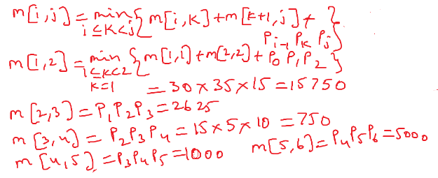

Slide 36
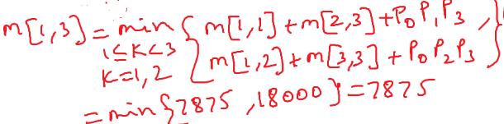
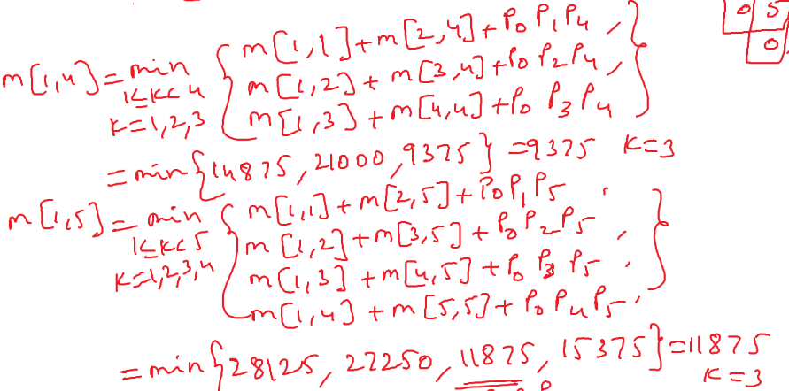

Slide 37
